Slide 1
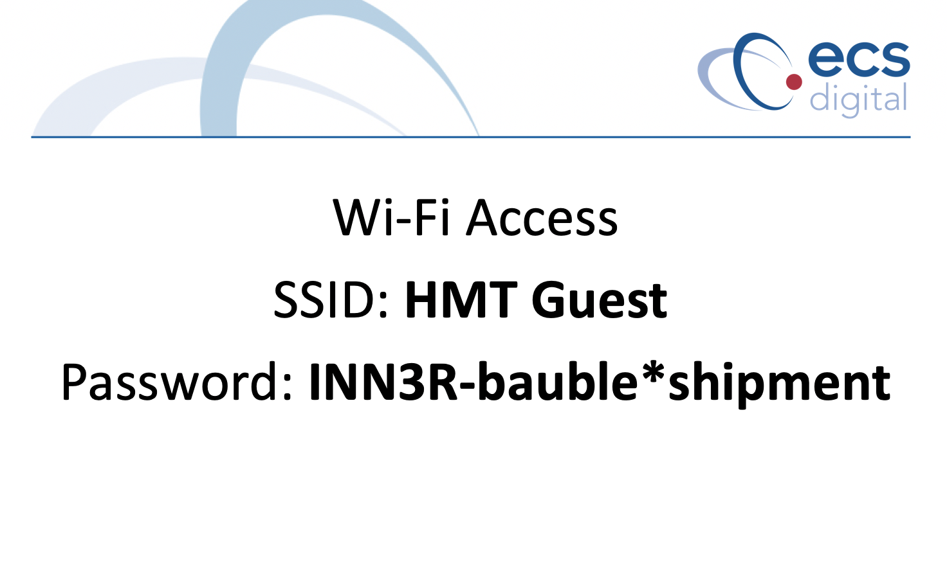
Notes:
First of all thanks to everyone for joining us for this DevOps Playground Meetup at ECS Digital.
Before we begin the session, has anyone not been able to access the Wifi?

Slide 2


Slide 3
DevOps Playground
Inspiring tech-enthusiasts to explore new technology during hands-on monthly events.
Notes:
Mention that there will be a session for questions during and after the workshop

Slide 4
Hands on with JMeter
Boris Levanov
Notes:
Introduce myself, and inform people that I’ll let them know
What JMeter is
How is it useful
Why you may want to adopt it

Slide 5
Introduction
Websites are becoming more complex
Successful project grows all the time
Revenue is also growing
More users - more strain on the servers
How do we identify where’s the limit?
One way: load test to find the breaking point
Notes:
Discuss how the internet is becoming a much more complex place than it once was, and how companies have to go an extra mile to increase their revenue. One way of increasing the revenue is attracting more users to their websites, which means more strain on the servers. It’s important to identify how the servers will respond to the increase. There is a solution to that dilemma: perform load testing on the infrastructure BEFORE the user influx occurs. This leads to…

Slide 6
Definition
The Apache JMeter™ application is open source software, a 100% pure Java application designed to load test functional behavior and measure performance. It was originally designed for testing Web Applications but has since expanded to other test functions.
Notes:
…JMeter. Discuss how it used to be a load and performance testing tool, but grew since then to be much more then that. It can cover a variety of other testing types, which be discussed further along the presentation.

Slide 7
Apache JMeter™ pros
Open source
Platform independent (uses Java)
Pipeline integration using plugins (i.e. Jenkins)
Multiple protocols (HTTP, FTP, SOAP, JDBC, JMS, and LDAP)
GUI programming available
Good support (I.e. Stack Overflow, Blazemeter)
Notes:
JMeter, like any other tools, has its pros and cons. We’ll go through the pros, first:
It’s open source, meaning everyone can contribute to it using the specific Jmeter contribution channels (see the Jmeter website)
It’s based on Java, which means it can run on a vast array of different infrastructures.
Can be integrated into your favorite Continuous Integration pipeline
It supports multiple protocols, such as HTTP, SOAP, FTP and others
It’s got user interface, which means you don’t need to know coding to develop the tests
And it’s got a variety of support resources, such as stack overflow, various articles all over the internet and, my personal favorite, the commercial support from the Blazemeter website

Slide 8
Apache JMeter™ cons
Advanced reporting is not easy to set up
Not compatible with all Java versions
GUI takes some time of getting used to
Notes:
It also has its cons.
If you want to perform detailed analysis on the data, you need to be good at statistics and doing graphs in excel.
Not all Java versions are supported. The website lists Java 8 and 9 as the ones officially supported, so it may misbehave on systems with other versions of Java
Even though GUI is good, it does take some getting used to. However, it’s not as difficult as learning how to code from scratch.

Slide 9
How does it work?
> Sends requests as a user would (threads)
> Can send multiple requests as different users
> Receives responses as a user browser would
> Records and visualizes the result
Notes:
How does JMeter works: well, it allows you to do actual API calls to the website as the user would make them using the browser. It can also receive the responses, and act upon them. Once the operation completes, you can see and analyze a variety of data associated with the response, such as latency, response size, headers, error codes etc.
With the ability to add more users (or threads), the responses will generate a realistic load on the system, which can then be recorded and analyzed.
Furthermore, JMeter has a few tools that allow you to visualize the data as it gets gathered.

Slide 10
Additionally
Can modify requests / responses uniquely per user
Supports per-user variables
Extendable modifiers, such as:
Password salting
Token generation
Coding / scripting supported
Notes:
It has some additional functionality:
You can modify the requests before they’re sent and after the response is received. This mean you can perform user logins without actually touching the login servers, which make your tests very specific.
Example use: pull your password salting code directly from the repository, and perform the salting on the machine where JMeter is installed
Because JMeter supports variety of scripting languages (beanshell, groovy, and even javascript) you can customize your API calls uniquely per user, thus adjusting the load exactly as you want it. This allows you to fine tune the website load very precisely as you want it to be.

Slide 11
Other Possible JMeter™ Uses
Versatile – can be used in a variety of ways
Example use 1: functional API testing with assertions
Example use 2: website benchmarking
Example use 3: application performance monitoring
Example use 4: web crawling, spidering
Notes:
Because of its customizability, JMeter can be used to emulate pretty much anything, with some effort.
1: can be used to ensure your API calls are checked for error codes. Every time you receive one, JMeter will fail the test.
2: Can be used to measure your website performance when a specific amount of users browse through it, thus creating a realistic expected response times.
3: The above can be maintained by running constant checks (say, every day) and looking at the graphs. This will visually let you know whether you performance increases and decreases, and thus will guide your development strategy
4: With some creative coding, can be used to scan your website for all the endpoints it has available to the user. This allows to identify slow-performing sections of the website, and even the ones that occasionally return error codes.

Slide 12

Login Details
Link: http://www.devopsplayground.com/guacamole/
User: user#
Password: password#

Slide 13
Workshop Agenda
Workshop Repository: https://bit.ly/2X1ash0
Exercise 1: Single API request
Exercise 2: Multiple API requests, variables
Exercise 3: Data Visualizations
Exercise 4: Web Crawler*
*Interpretation of crawler based on https://medium.com/@DragosCampean/how-to-create-an-advanced-website-crawler-with-jmeter-e822715fc1f8
Notes:
Stage 1:
Create and measure single API request
Describe what a thread is
Add an HTTP sampler (enter protocol and website manually) https, https://www.crawler-test.com/
Describe requests (and can be affected by a pre-processor)
Describe responses (and can be affected by a post-processor)
Add a simple listener
Add a loop logic controller and describe what it does
Stage 2:
Amend the previous stage to add more API requests
Add another thread group
Add another sampler
Rename both samplers to differ
Export the protocol and processor into a variable
Apply those to the first sampler
Run both and see the error
Simple listener: not enough
Add an aggregate listener, explain what it does
Stage 3:
Talk about listeners
Add a summary listener
Add a graph results listener
Stage 4:
Open the web crawler file
Explain briefly what are pre and post processors
Ask users to do the following:
Extract the website name to a variable
Add visualisers and save results into a file
Try to identify why the crawling is so slow

Slide 14
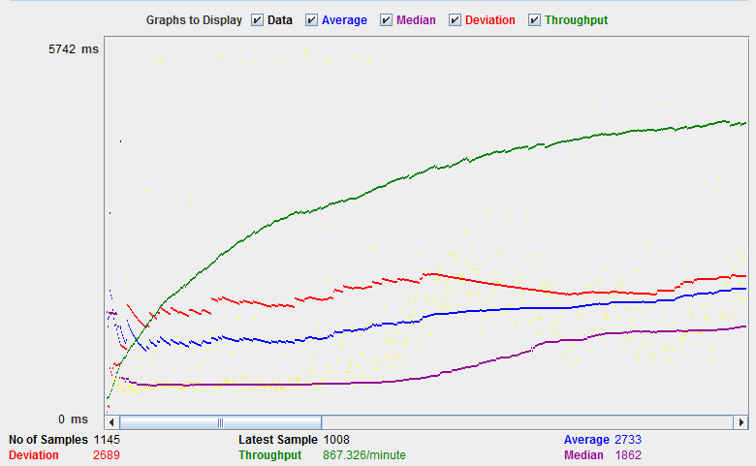
Types of JMeter™ visualizations
Native display
https://www.guru99.com/jmeter-performance-testing.html

Slide 15
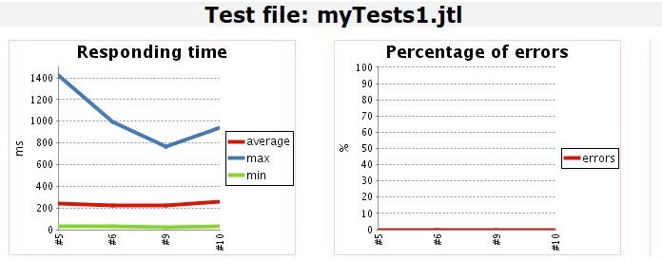
Types of JMeter™ visualizations
Jenkins integration
https://www.guru99.com/jenkins-jmeter-blazemeter.html

Slide 16
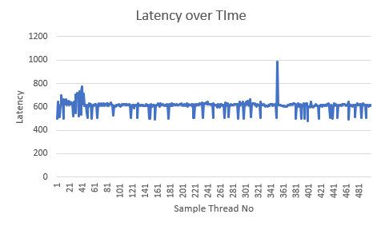
Types of JMeter™ visualizations
Simple excel example
https://www.guru99.com/jenkins-jmeter-blazemeter.html

Slide 17

Questions?
Any questions? Stay for a chat!
Or email me: Boris.Levanov@ecs-digital.co.uk

Slide 18
Conclusion
Control quality is about both prevention and inspection.
- Gail Raynus
Performance is about retaining users. About improving conversions. About people.
- Jeremy in Oslo (@malchata)

